Slide 1
Interaction Concept
implicit music sequencer
Neudecker, Lückert

Slide 2
Technologies
Software
Hardware
Setup

Slide 3



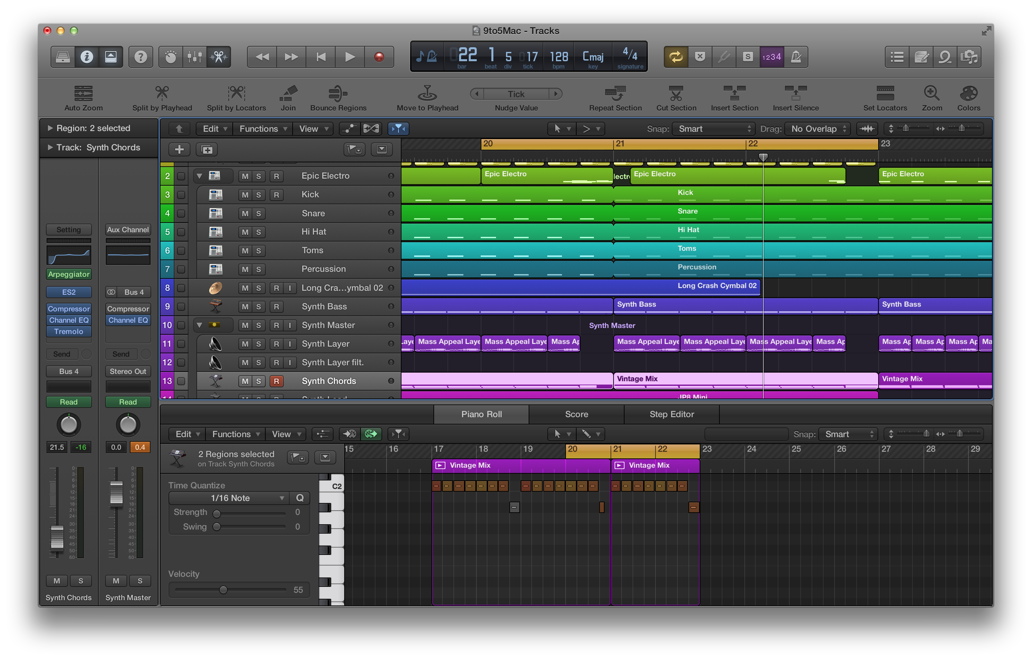

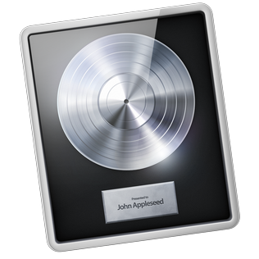
Software

Slide 4
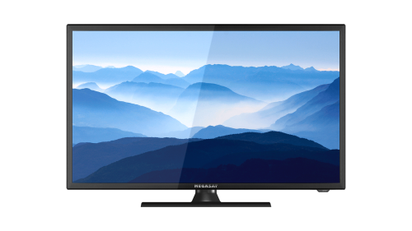
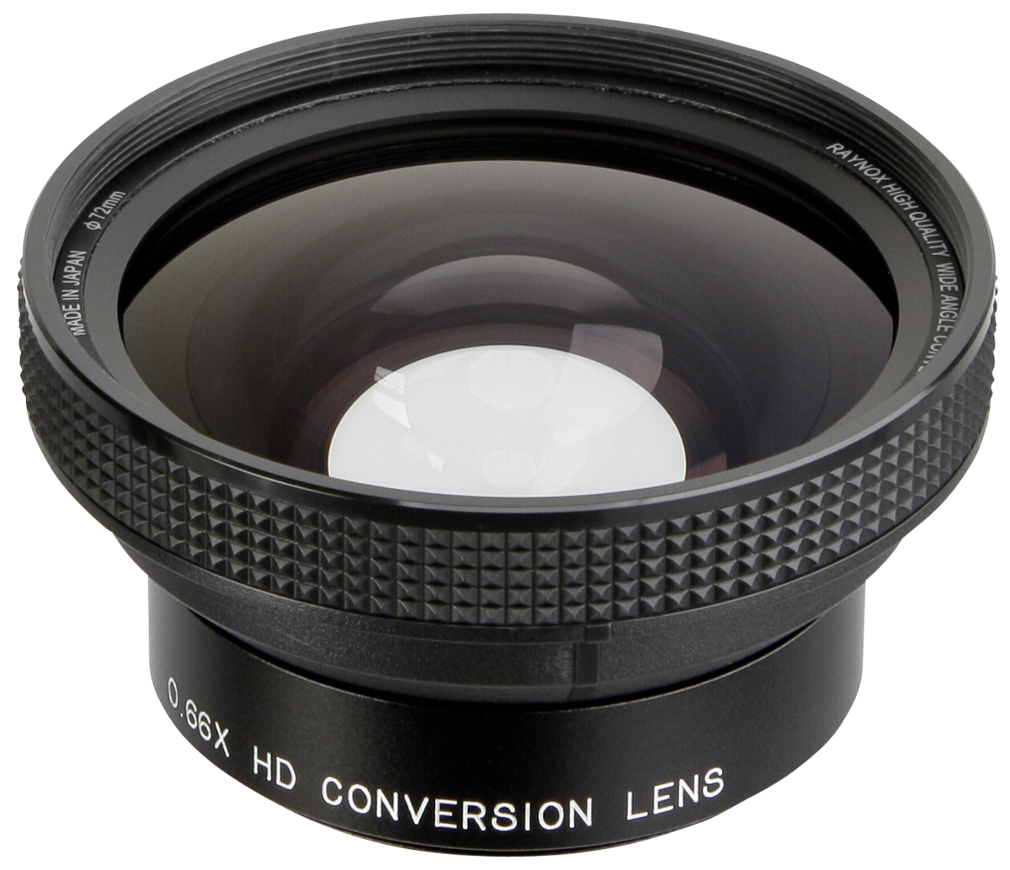
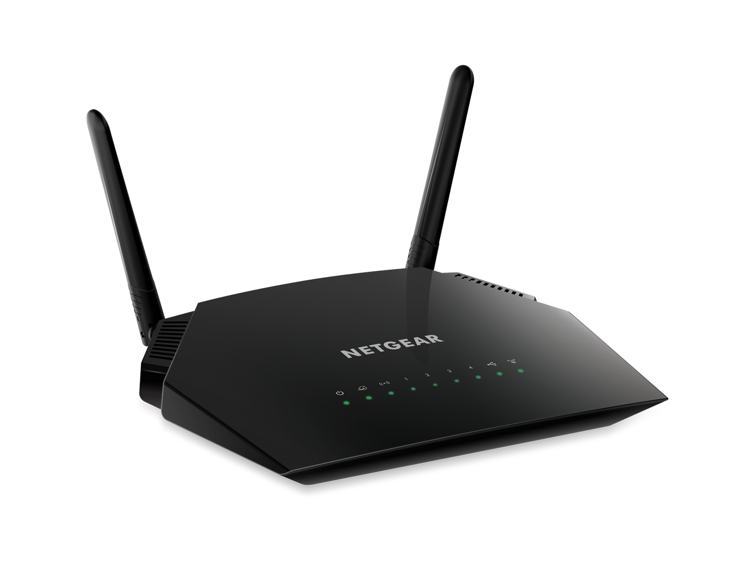
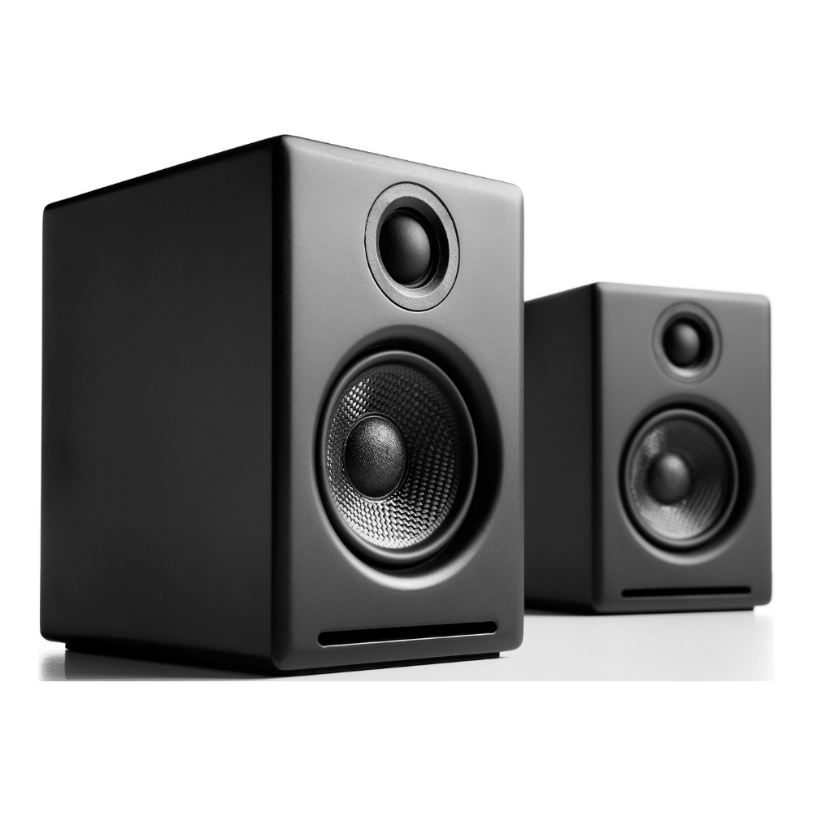
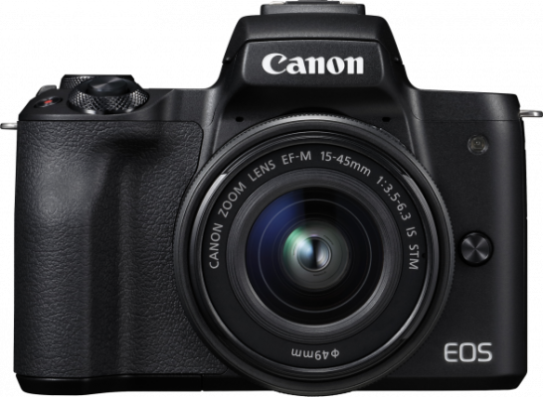
Hardware

Slide 5
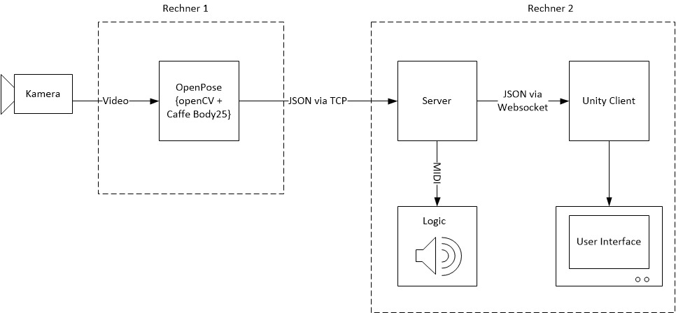
Setup

Slide 6
Input Mechanisms
Explicit Input
Hand positions
control visual cue positions
control intrument parameters
Person position
controls instrument selection

Slide 7
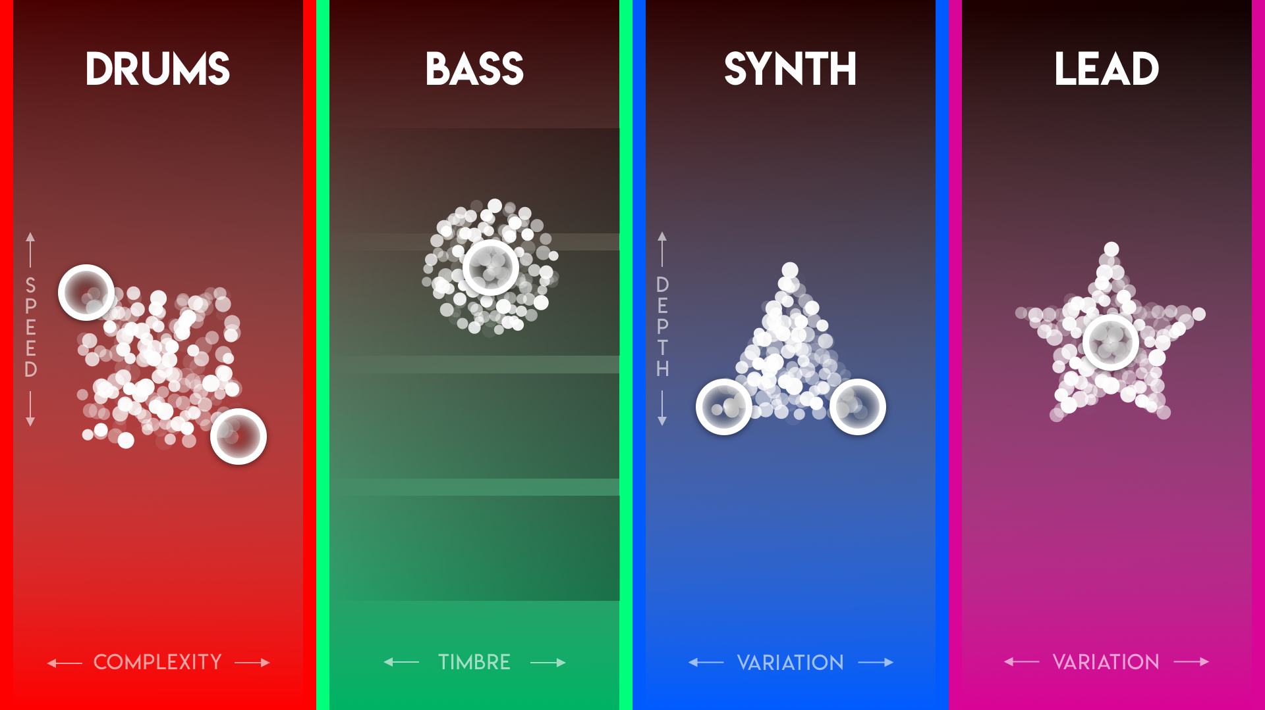
Input Mechanisms
Explicit Input

Slide 8
Input Mechanisms
Implicit Input
appearance controls active state of instrument

Slide 9
Input Mechanisms
Implicit Input

Slide 10
Input Mechanisms
Implicit Input

Slide 11
Input Modalities
Camera

Slide 12
Input Options
Media Capture
Video

Slide 13
Output Modalities
Vision (Screen, Beamer, LED-Wall)
Audition (Speaker)

Slide 14
Output Options
visual
static
text
animated
graphics
audio
music

Slide 15
Data Collection
Pose Estimation Data
Number of persons
Bone position
Confidence score
Parameter settings
each instrument
timestamp | Tracked persons count | Interacting persons count | Person 1 left hand position | Person 1 left hand confidence | … | Midi data
14.01.2020 | 7 | 4 | (100, 200) | 0.78 | … | 0x6f2c77

Slide 16
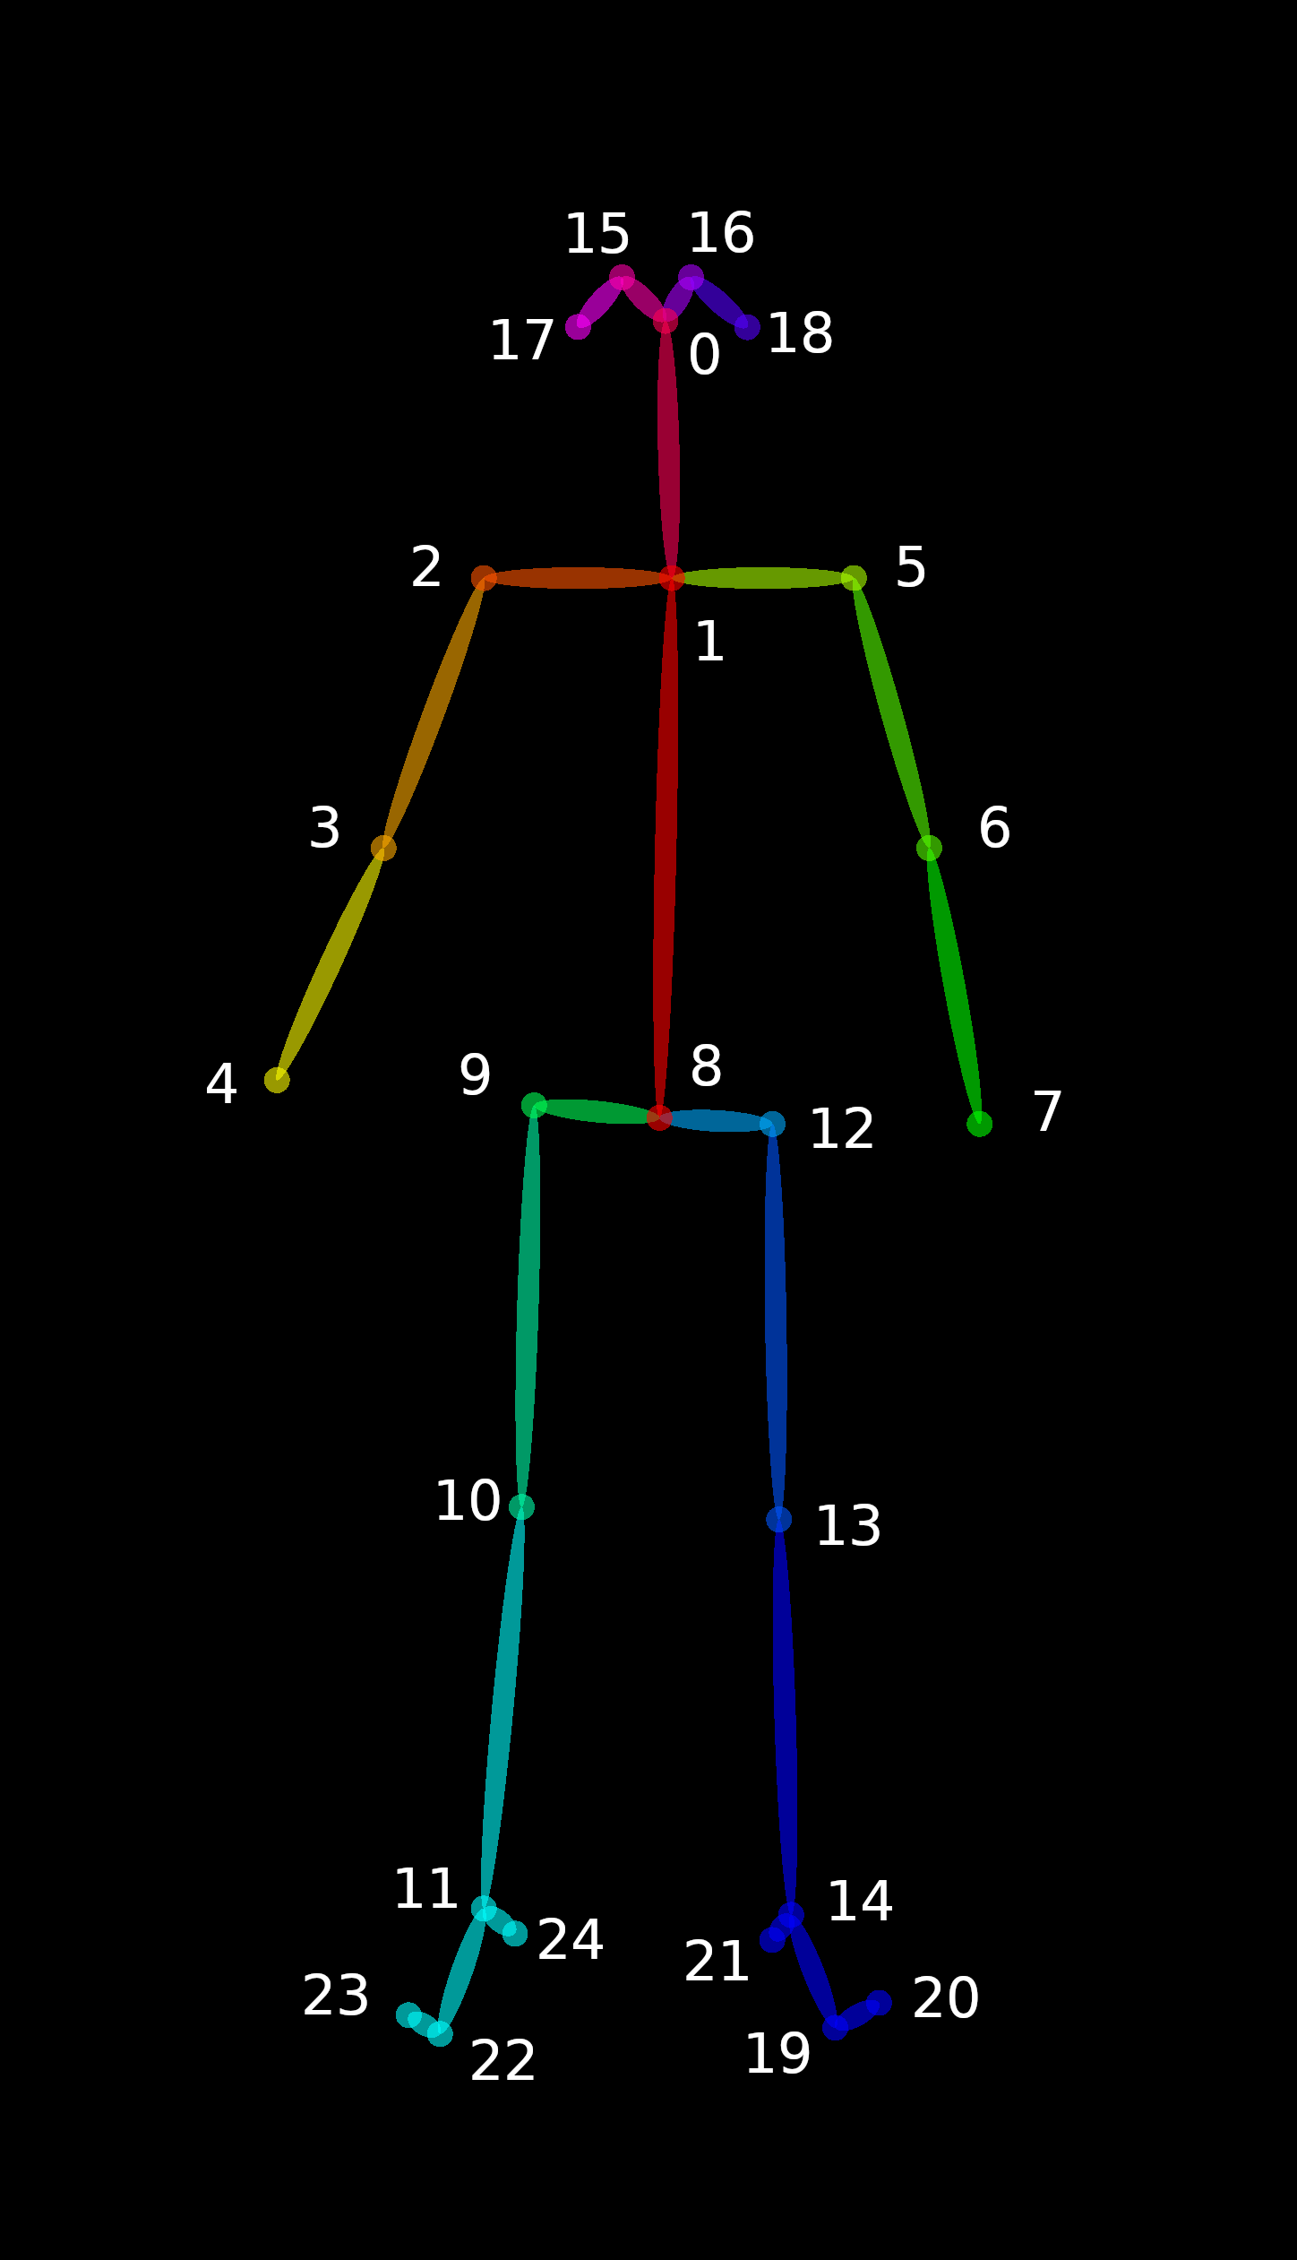
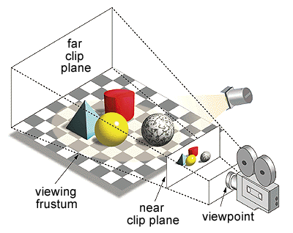
Transfer Function
Bone Position with (x,y) coordinates
Mapping to z-position (y value of ankle bone)

